Slide 1
Research Impact and Open Science
Francis Oloo (Dr. rer. Nat)

Slide 2
Outline
Recap of Session 3 – Results to Discussion
Foundations of “Research Impact”
Discuss methods for planning/documenting for research impact
Practical ways of ensuring visibility of research

Slide 3
Recap
In session 3 of this module, we looked at how to use the 5-Step MOVE model to describe the discussion
The MOVE model contains 5 sequential steps Background → Summarize or report → Comment → Highlight Limitations → Recommendations
The method is applicable both for quantitative and qualitative research methods

Slide 4
Recap 5-Step Move Model (Social Science)
Original research question (Introduction): How do smallholder farmers describe and justify their decisions about whether to adopt a new drought-tolerant maize variety?
Move 1 – Background: This study set out to understand how farmers describe and justify their decisions to adopt or reject a new drought-tolerant maize variety.
Move 2 – Summarizing key results: Three themes emerged from the interviews: trust in extension officers, concern about the upfront cost of seed, and social proof, that is, farmers were strongly influenced by whether trusted neighbours had already tried the variety.
Move 3 – Commenting on key results: Social proof appeared more influential in farmers' own accounts than the formal extension messaging which the programme had relied on. This contrasts with prior adoption studies that emphasize economic rationality as the primary driver. Cost concerns were also more prominent among smaller landholders, likely reflecting their thinner margin for risk if the new variety underperformed.
Move 4 – Limitations: These themes come from a purposively sampled group of adopters and non-adopters in one district, so the findings describe patterns of reasoning rather than how common each view is across the wider farming population.
Move 5 – Recommendations: Extension approaches should incorporate peer-to-peer demonstration alongside formal messaging, directly answering the original research question by showing that farmer adoption of new variety is substantially a social, not just economic, process.

Slide 5
Research Impact
Research impact refers to the demonstrable contribution that research makes beyond academia to policy, practice, economy, environment, and society

Slide 6
Output→ Outcome→ Impact
Research Impact is distinct from academic output and outcome.
OUTPUT
OUTCOME
IMPACT
What is produced
Immediate change in knowledge, attitude, capacity
Longer-term, wider societal or environmental change
A paper on drought-resistant maize varieties
Farmers adopt the new variety after training
Measurable reduction in crop failure; improved food security

Slide 7
Domains of Impact
Contribution → The areas of research impact including economy, environment, health, quality of life, community, organization etc.
Avenues → Mechanisms or Processes by which research could have impact e.g. Effects on knowledge, understanding, awareness and/or attitudes
Change → Effect or benefit to the area of influence
Levels → Scale e.g. individual, local national, international
Alla, K., Hall, W. D., Whiteford, H. A., Head, B. W., & Meurk, C. S. (2017). How do we define the policy impact of public health research? A systematic review. Health research policy and systems, 15(1), 84. https://link.springer.com/content/pdf/10.1186/s12961-017-0247-z.pdf

Slide 8
Frameworks for planning and tracing impact
Logical Framework Approach: Matrix linking inputs, activities, outputs, outcomes, and goal — with indicators and assumptions
Theory of change: Matrix linking inputs, activities, outputs, outcomes, and goal — with indicators and assumptions
Outcome mapping: Focuses on behavior change in "boundary partners" rather than distant, hard-to-attribute impacts
Contribution analysis: Builds a credible, evidence-based case for research's plausible contribution alongside other factors

Slide 9
Sample Log frame
Narrative Summary | Objectively Verifiable Indicators (OVIs) | Means of Verification (MOV) | Assumptions
GOAL (IMPACT)
Improved food security and climate resilience for smallholder farming households | % reduction in household food insecurity in target districts within 3 years of variety release | District food security surveys; national agricultural statistics | Broader food system factors (markets, infrastructure) do not undermine household-level gains
PURPOSE (OUTCOME)
Smallholder farmers adopt the drought-tolerant maize variety in place of the local check variety | % of farmers in target sites growing the new variety by end of Year 2; average yield loss under drought compared to local check | Household adoption surveys; follow-up yield sampling | Farmers who adopt continue planting the variety across multiple seasons, not just a single trial season
OUTPUTS
1. Field trial evidence on yield performance under drought 2. Farmers trained on variety management 3. Extension materials disseminated | Number of trial sites completed; number of farmers trained (disaggregated by gender); number of extension materials distributed | Trial site reports; training attendance registers; distribution logs | Extension officers deliver training as designed; materials reach intended farmers
ACTIVITIES
1.1 Conduct randomized field trials across 3 sites 2.1 Deliver farmer training sessions 3.1 Develop and print extension materials | Trial protocol adherence rate; number of training sessions delivered on schedule | Field diaries; session logs; budget/expenditure records | Timely funding disbursement; favorable weather allows trials to proceed as planned

Slide 10
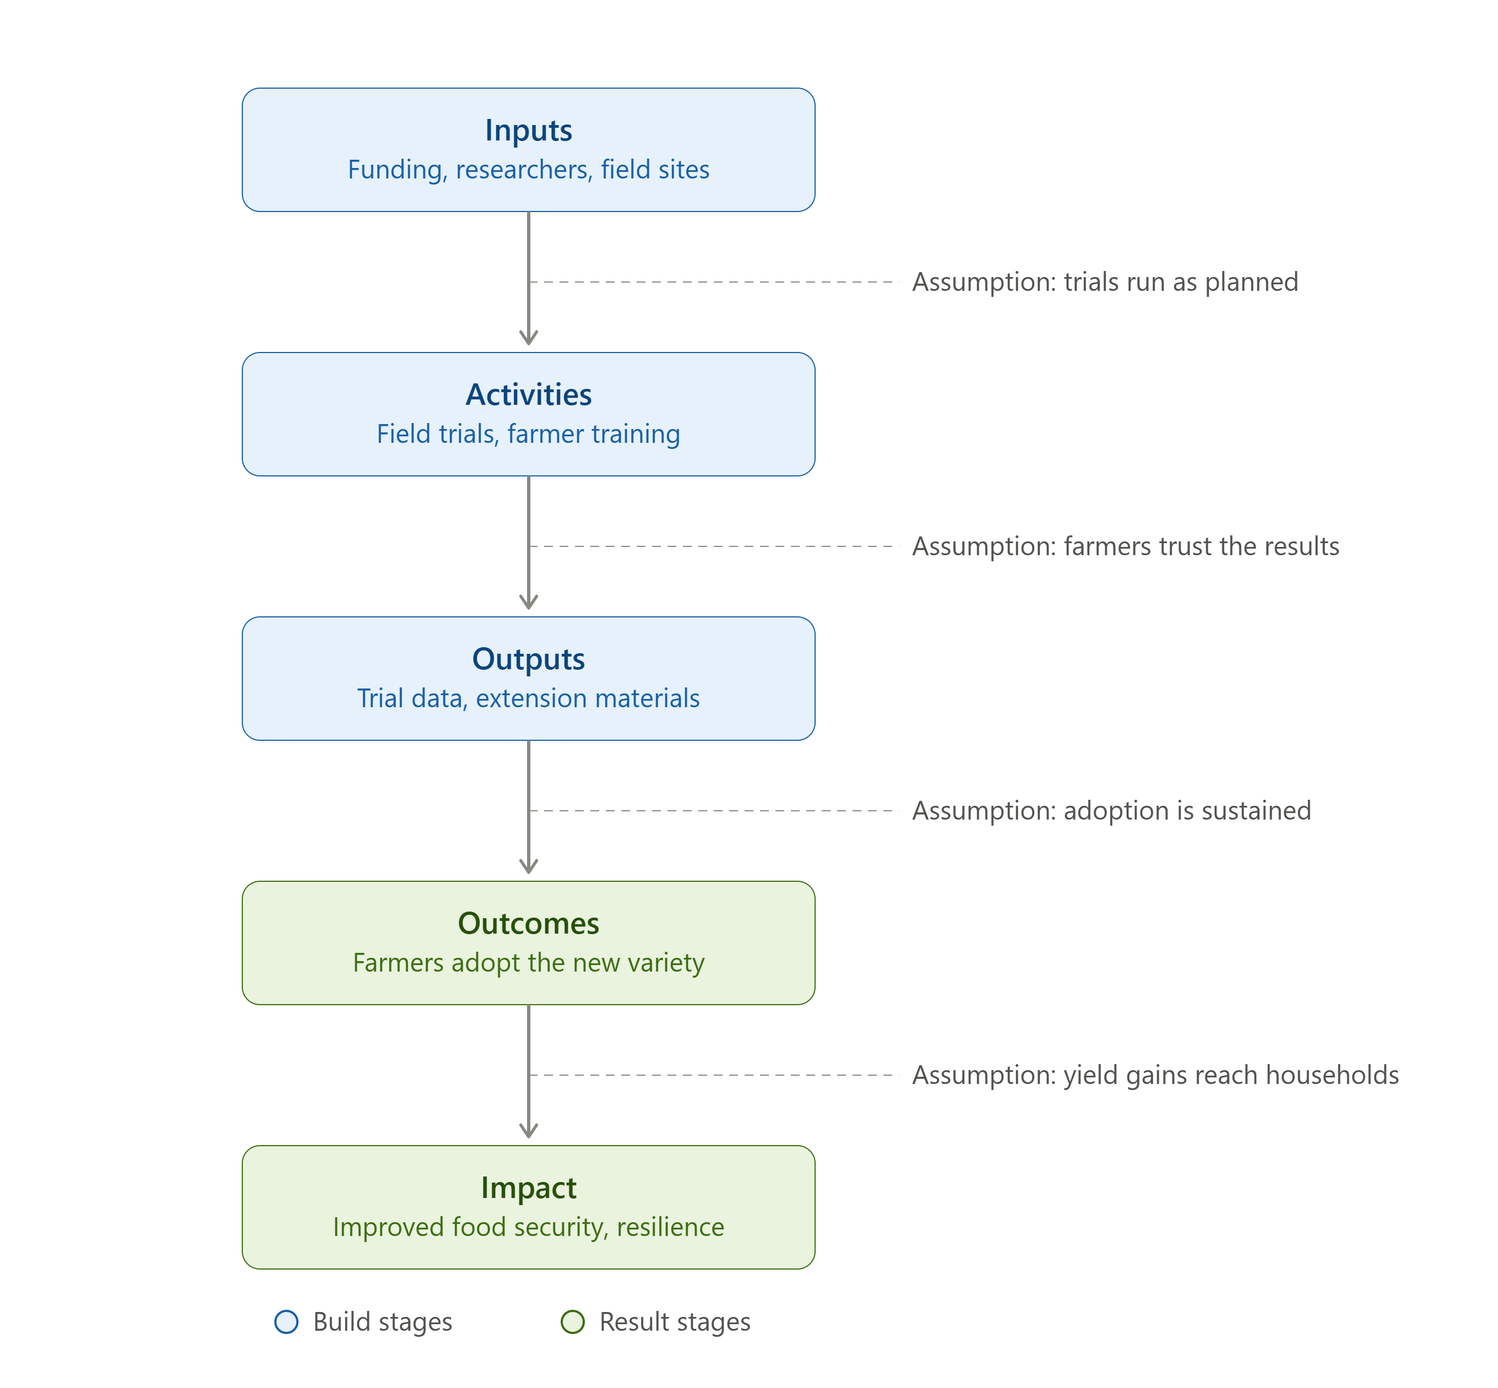
Sample Theory of Change
Inputs → Activities → Outputs are the "build" stages — the parts a research team directly controls (funding, fieldwork, training materials).
Outcomes → Impact are the "result" stages — changes in the world that depend on other people acting (farmers adopting, households benefiting), which the project can influence but not fully control.
Each arrow carries its own assumption — the thing that has to hold true for the pathway to keep moving forward.

Slide 11
Measuring impact, example
Domain | Example Indicator
Policy | Adaptation policies/bills citing the research
Practice | Farmers/communities adopting a practice from the research. Use of new tools from the research
Capacity | Researchers trained and using tools from research
Resilience | Reduction in crop loss or displacement based on adoption of the knowledge from research
Finance | Finance mobilized citing the evidence

Slide 12
Pitfalls undermining research impact
Principles of maximizing Research Impact
Design for impact at the onset
Invest in translation capacity
Build durable relationships with policy & community actors
Build durable relationships with policy & community actors
Track outcomes, not just outputs
Plan for resource mobilization as part of impact strategy
Treating dissemination as equivalent to impact
Designing impact plans only after research is complete
Over-claiming attribution for multi-actor outcomes
Producing policy briefs with no follow-up engagement
Ignoring negative or null results
Under-investing in translation capacity

Slide 13
Assignment
1
Map the primary users, influencers, and beneficiaries of your research outputs
2
Sketch log frame of research question to include activities, outputs, out comes and impact. Also include the verifiable indicators, means of verification and assumptions

Slide 14
Questions and discussions

